Slide 1

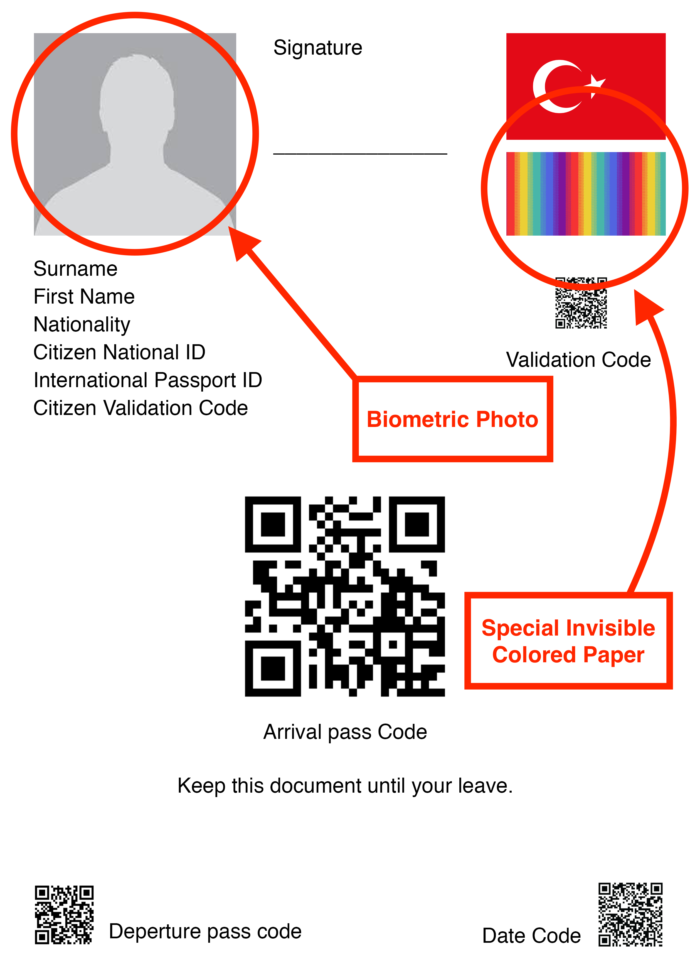
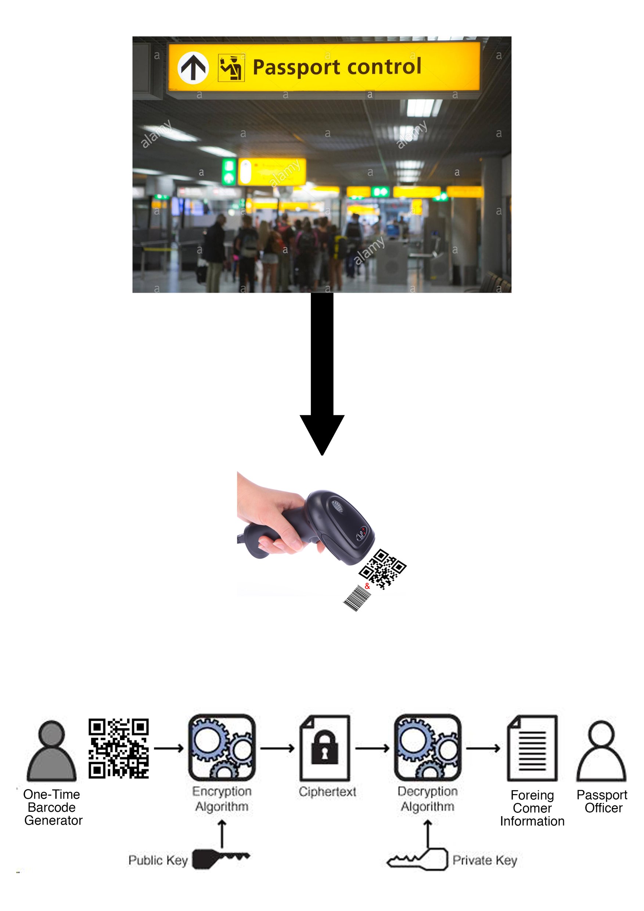
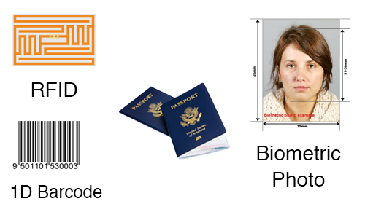
New Approach to Passport Authentication and Security: Self Printed Passport
Ahmet Can Turgut
Passport Security
Self Printed Passport
Passports are legal documents that allow you to pass from one national to another. Technology developed on passports gained momentum after 9/11 attacks in United States of America [1].
Due to dramatic increase of immigration passport security's importance increase dramatically.
Current booklet passports can be tempered easily.
Current Passport Techniques on Booklet Passports
Self Printed Passport Example
System Architecture
Traditional passports can be modified, but self-printed passports are disposable - only one time use -. This increase uniqueness and decrease changeability of the passport.
Using encryption and decryption (digital signature) it increase confidentiality of the passport. But in this case trusted authority may cause problem. For the solving this issue, 4 different 2-D barcodes can be used for specified for the countries. 2-D barcodes increase variety of the barcodes.
Self-printed printed passports also include color monitored paper. These papers provided by governments to citizens. These papers increase validity of the passports.
COMP 434/534 COMPUTER AND NETWORK SECURITY
Notes:
1

